Slide 1
A WINNING PROPOSITION

Slide 2
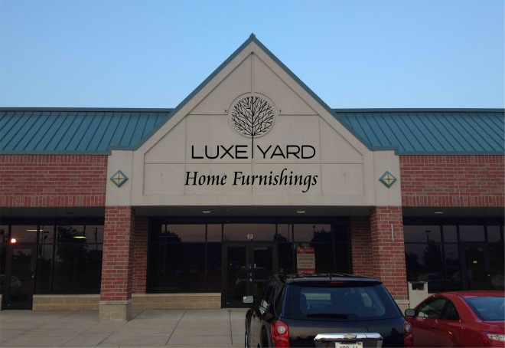
What is LUXEYARD?
LUXEYARD.com is a national online retailer that offers high quality home furnishings at highly discounted prices. LUXEYARD recently opened its first outlet store in North Aurora, Illinois.
Opening LUXEYARD.com Outlet now allows the general public the opportunity to come in person and shop for LUXEYARD Home Furnishing at even lower prices offered online and without the hassle of shipping.
All Customers become a registered member and receive a LUXEYARD Card saving them at least 20% on all LuxeYard.com Outlet products and at least 10%* at any of our Affiliate Partners
products and services.
Registration for the LUXEYARD card is free.
*Participating affiliates must agree to honor
at least a 10% discount on its products and services

Slide 3
The LUXEYARD Card
Card is issued and activated at your store.
Card can be Co-Branded with your company name and logo (certain conditions apply).
A LuxeYard terminal will be issued to you at no cost. You will need to provide a phone or Ethernet connection to connect the terminal.
Terminal acts as Coupon Redemption center and Gift Card center.
Additional marketing and advertising tools available with LuxeYard program.

Slide 4
How does it work?
LUXEYARD Kiosk terminals are located at various business’ around the greater Chicago area promoting the LUXEYARD brand and driving consumer traffic to our LUXEYARD Outlet Store and our Affiliate Partners.
When a Customer purchases a Coupon at a LUXEYARD Kiosk it will double up and convert any amount inserted into LUXEYARD Coupons called LuxeBucks!
For example, inserting $10, rewards the customer with $20 in LUXEYARD LuxeBucks - DOUBLE THE VALUE.
LuxeBucks can be used at any of our LUXEYARD retail locations and online at www.LUXEYARD.com for at least 20% off purchase(s). Additionally LUXEYARD cards can be used at any of our Affiliate Partners for at least a 10% discount.
In addition, the customer can participate in our promotional Sweepstakes, for a chance to win a cash prize!

Slide 5
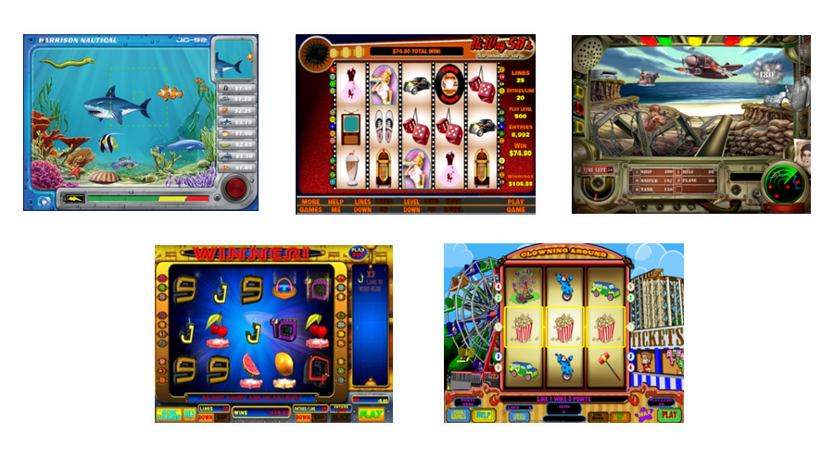
Kiosk & Entertainment
In addition to providing LUXEYARD Coupons, LUXEYARD Kiosks also come with high quality, engaging entertainment for customers to play!

Slide 6
How are products promoted?
The state of Illinois allows “sweepstakes” to promote the sales of products. There is a statue that sets the requirements for a valid product promotion or a sweepstakes. The key aspects for a valid product promotion are:
That there is a legitimate product being promoted (i.e. McDonald’s via Monopoly; Dunkin Donuts via scratch off and Coke twist the cap via mycokerewards.com)
That there is a free method of entry (“No Purchase Necessary”); and
That the chance of winning a prize is the same for those who enter via the No Purchase Necessary as for those who purchase a product.
With these key elements met, a sweepstakes is lawful in Illinois under statute 720 ILCS 28-5 subsection (a) and (b), amended by the Illinois legislature in 2012.
In 2013, the Governor signed a clarification to the Video Gaming Act to make clear that a sweepstakes is deemed lawful under the criminal code, did not violate the Video Gambling Act.
Section 35 of the VGA now allows a game device that is lawful under the criminal code.
As a result, a valid sweepstakes that resembled a video poker game is lawful under the VGA.

Slide 7
Is there when you need us
In the event the promotion comes into question via an issued complaint, Windy City Promotions will provide support under the following conditions:
The product promotion is conducted using an approved kiosk;
The kiosk is provided by Windy City Promotions or it’s approved designee;
The complaint or citation is issued for an alleged violation solely to a product promotion kiosk;
The complaint is reported to Windy City Promotions within 48 hours of receipt of the notice of violation.

Slide 8
What are the benefits?
Your location revenue will skyrocket as a portion of sales from each LUXEYARD Kiosk goes directly into your pocket (Excluding any licensing and/or promotional costs).
Provides great entertainment value for your customers through our promotional sweepstakes.
Partnering with LUXEYARD will generate a loyalty fan base with more customers through cross-branding opportunities.

